Slide 1
MCA Final Year Project
Hodophile
Your Smart Travel Companion
Submitted by: Prangya Paramita Satpathy , Rakesh Kumar Chand , Swarupananda Rana , W.Lingaraj
Guide: Prof. Pravakar Mishra, HOD, Dept. of MCA
NIIS Institute of Business Administration | BPUT, Odisha | 4th Sem MCA | 2025
✈

Slide 2
AGENDA
What We'll Cover
1
Project Overview & Problem Statement
5
Implementation Highlights
2
Literature Review & Proposed Solution
6
Testing & Results
3
System Architecture & Technology Stack
7
Future Enhancements & Conclusion
4
Key Modules & Features

Slide 3
OVERVIEW
Project Overview & Problem Statement
🌍 What is Hodophile?
⚠ Problem Statement
Hodophile is an AI-powered, full-stack web application that transforms travel planning into a single, seamless experience. Built with: Python Flask · HTML/CSS/JS · SQLite · Gemini AI · OpenWeatherMap API Target Users: Students, families, solo travellers and travel enthusiasts looking for a one-stop planning platform.
🔀 Fragmented platforms – users switch between 4–6 apps to plan one trip
🤖 No AI assistance for real-time, personalised guidance
🌦 Weather data not integrated into the planning workflow
💾 No unified memory storage for travel photos & journals
💰 Budget tools are absent or not tied to recommendations

Slide 4
SOLUTION
Proposed Solution & Objectives
Hodophile integrates trip planning · AI chat · live weather · budget tools · and travel memories into ONE platform.
1
Generate personalised day-wise itineraries using Gemini AI based on destination, budget, group size & travel type
2
Provide real-time weather data (OpenWeatherMap) integrated directly into the planning workflow
3
Offer an interactive AI chatbot for 24/7 travel guidance, Q&A, and recommendations
4
Enable budget-aware planning with cost-aligned suggestions for accommodation, food & transport
5
Allow users to upload, store and revisit travel memories (photos/videos) in a personal gallery
6
Deliver a fully responsive, premium web UI with dark/light mode support

Slide 5
ARCHITECTURE
System Architecture
🖥 Frontend Layer
⚙️ Backend Layer
🗄 Data Layer
HTML · CSS · JavaScript
Python Flask (Routes & Logic)
SQLite Database
Responsive UI (Dark/Light Mode)
users · trips · memories tables
Fetch API (Async Requests)
Gemini API Integration
File Storage (uploads/)
Canvas Particle Animation
OpenWeatherMap API Integration
Environment Variables (.env)
External APIs
🤖 Google Gemini AI
🌤 OpenWeatherMap
🗺 Google Maps Links
📁 File Upload (Werkzeug)

Slide 6
TECH STACK
Technology Stack
🐍 Python
🌶 Flask
🗄 SQLite
🌐 HTML
🎨 CSS
⚡ JavaScript
🤖 Gemini AI
🌤 OpenWeather
💻 VS Code
Why this stack? All components are open-source, free, and industry-standard. Flask enables rapid development; SQLite requires zero configuration; Gemini AI brings cutting-edge natural language intelligence; and the frontend trio (HTML/CSS/JS) ensures universal browser support. Total development cost: ₹0.

Slide 7
MODULES
Key Modules & Features
🔐
🗺
🤖
Auth Module
Trip Planner
AI Chatbot
Secure registration & login with SHA-256 password hashing and Flask session management
AI-generated personalised itineraries via Gemini API based on destination, budget & travel style
Real-time conversational assistant using Gemini LLM for travel tips, Q&A & recommendations
🌤
💰
📸
Weather Module
Budget Mgmt.
Memories
Live weather data from OpenWeatherMap — temperature, humidity, wind speed, travel advisories
Budget-aligned plan generation with cost breakdown across stay, food, transport & activities
Photo upload, gallery display, delete management — personal digital travel journal feature

Slide 8
DATABASE
Database Design (SQLite)
🗄 users
🗄 trips
🗄 memories
id (PK)
id (PK)
id (PK)
name
user_id (FK)
user_id (FK)
email
destination
file_name
password (hash)
days / budget
caption
photo
travelers / vibe
upload_date
created_at
month / itinerary
created_at
Relationships: users (1) → trips (many) · users (1) → memories (many) · All passwords stored as SHA-256 hashes

Slide 9
IMPLEMENTATION
Implementation Highlights
1
User Input
# Gemini API call (Flask)
Destination, budget, group size & travel type entered via the responsive planning form
def call_gemini(prompt):
url = GEMINI_BASE_URL
payload = {
"contents": [{
"parts": [{
"text": prompt
]} }
resp = requests.post(
url, json=payload)
return resp.json()
["candidates"][0]
["content"]["parts"][0]
["text"]
2
Flask Routes
POST /plan-trip receives data, validates inputs, builds structured Gemini prompt
3
Gemini API
LLM generates full day-wise itinerary, food tips, attractions & budget advice
4
Data Storage
Plan saved to SQLite trips table linked to the authenticated user's account
5
Rendered UI
Result page shows itinerary, budget breakdown, weather card & Google Maps link

Slide 10
TESTING
Testing & Results
25
25
100%
0
Test Cases Executed
Cases Passed ✔
Pass Rate
Critical Defects
Test Type
Description
Result
Unit
User signup with valid data
✔ Pass
Unit
Login with invalid credentials
✔ Pass
Unit
Weather fetch for unknown city
✔ Pass
Integration
Register → Login → Generate Plan → Save to DB
✔ Pass
Integration
AI chat: JS → Flask → Gemini → JS response
✔ Pass
System
Full journey on mobile (320px) – responsive check
✔ Pass
System
Gemini API quota exceeded – graceful fallback shown
✔ Pass

Slide 11
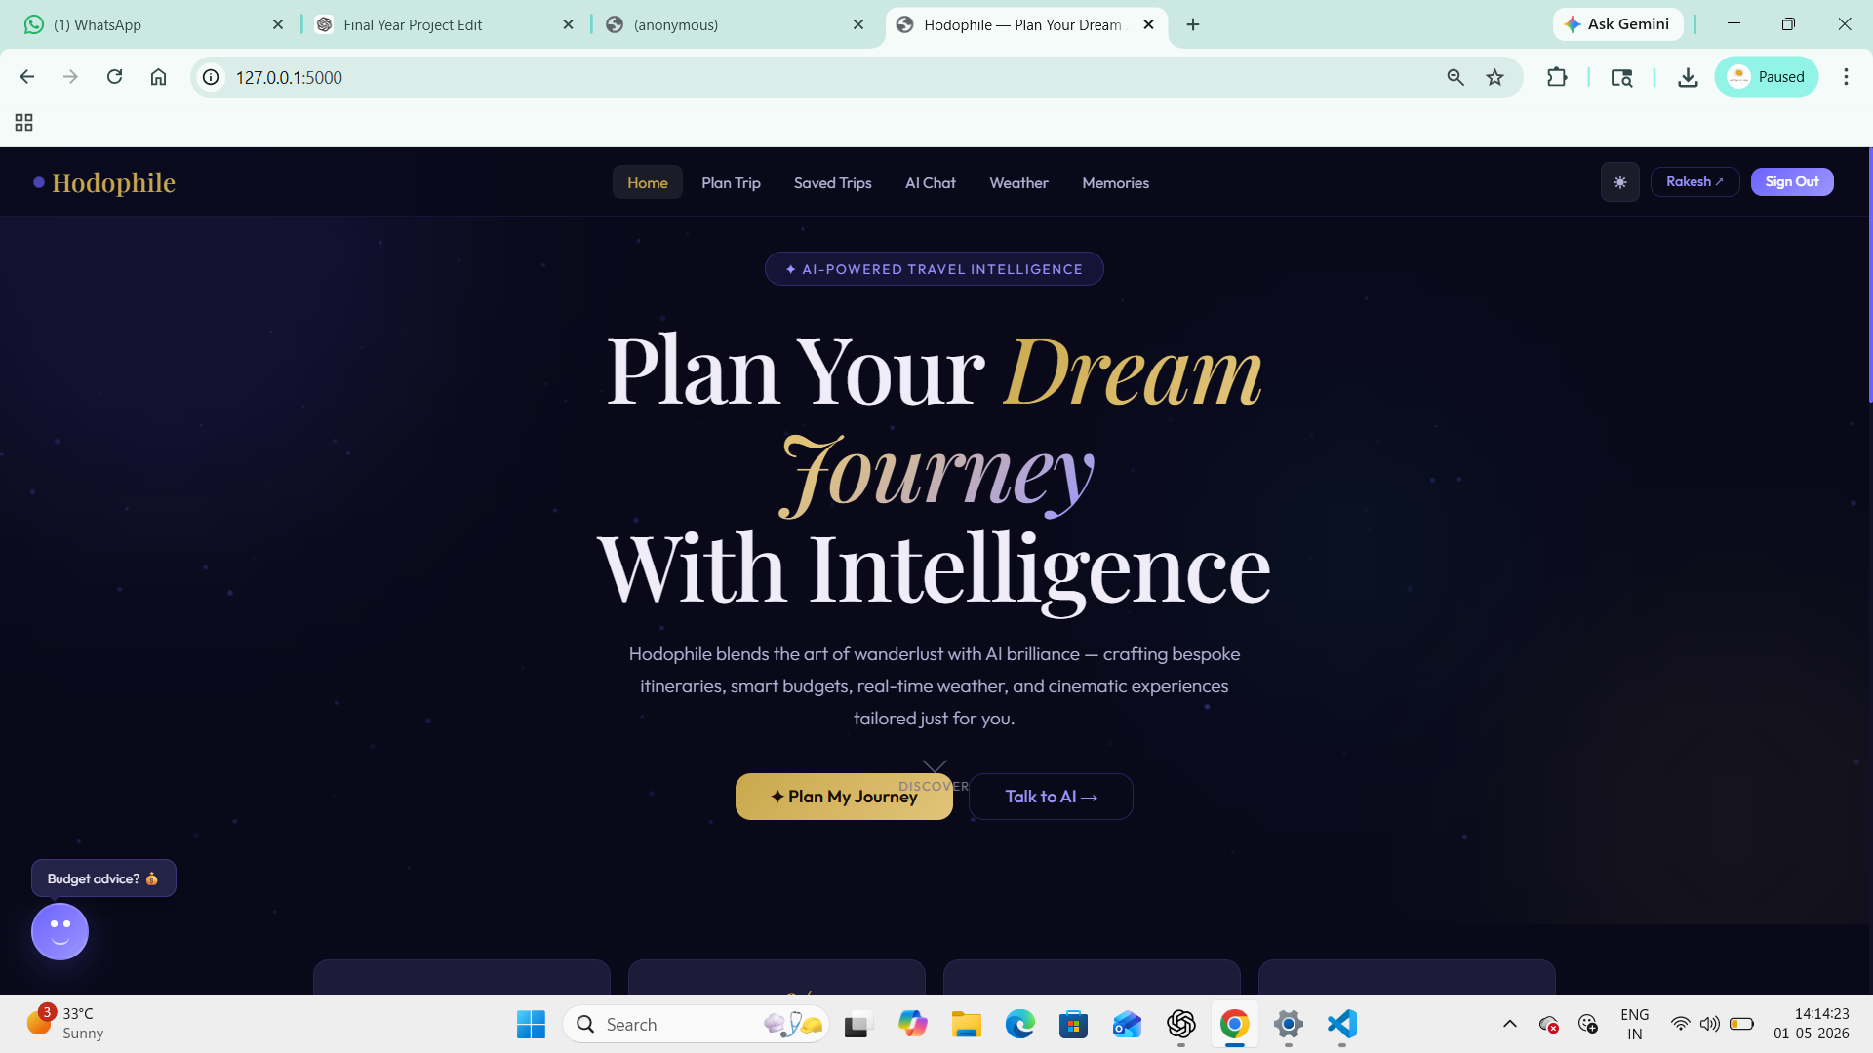
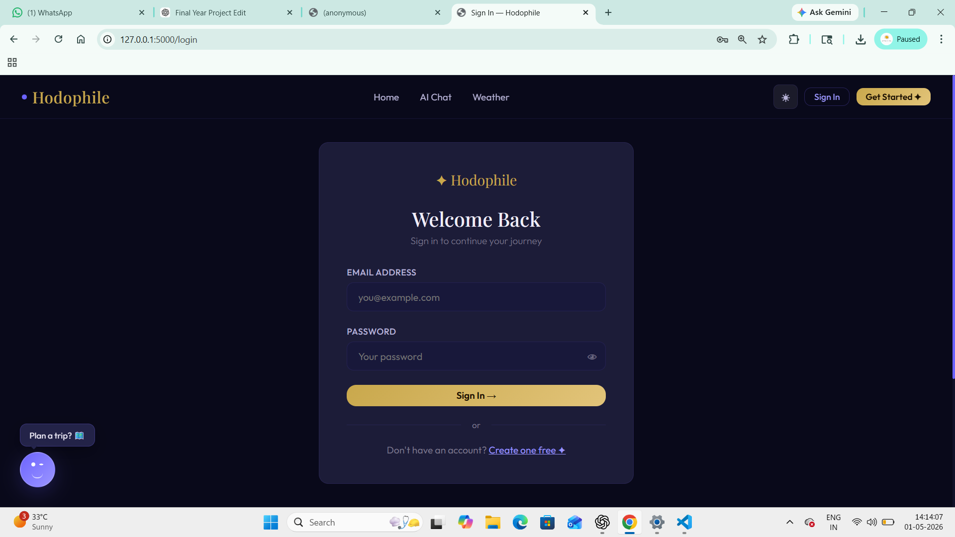
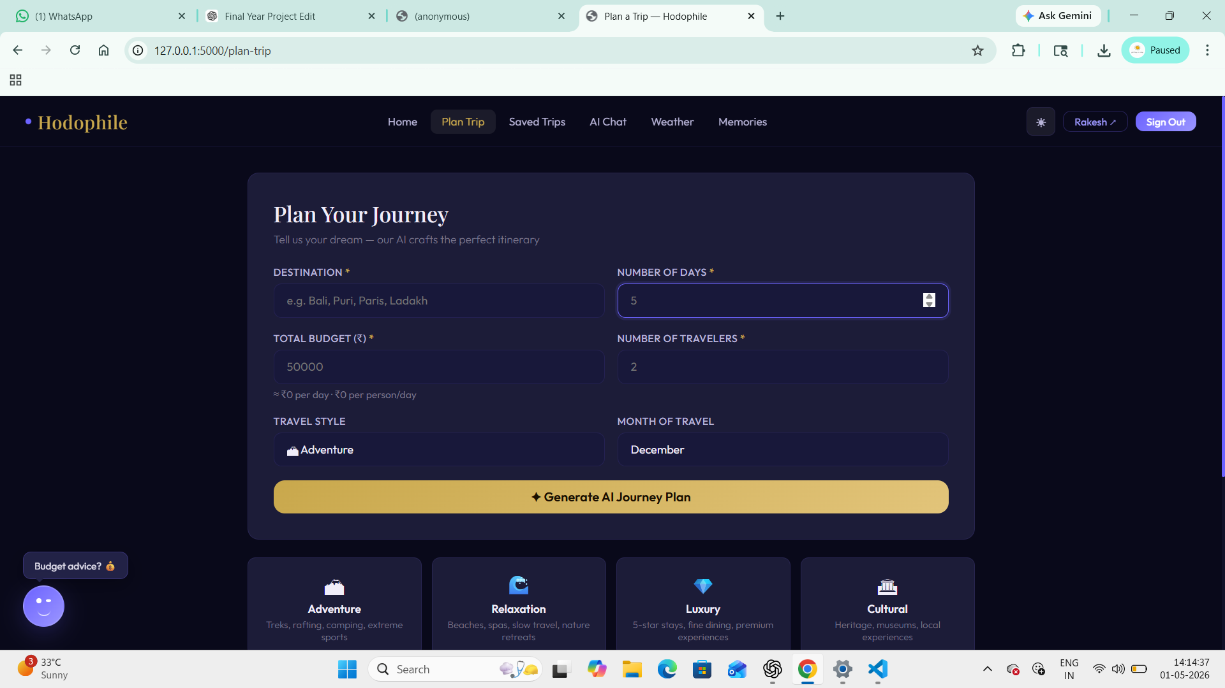
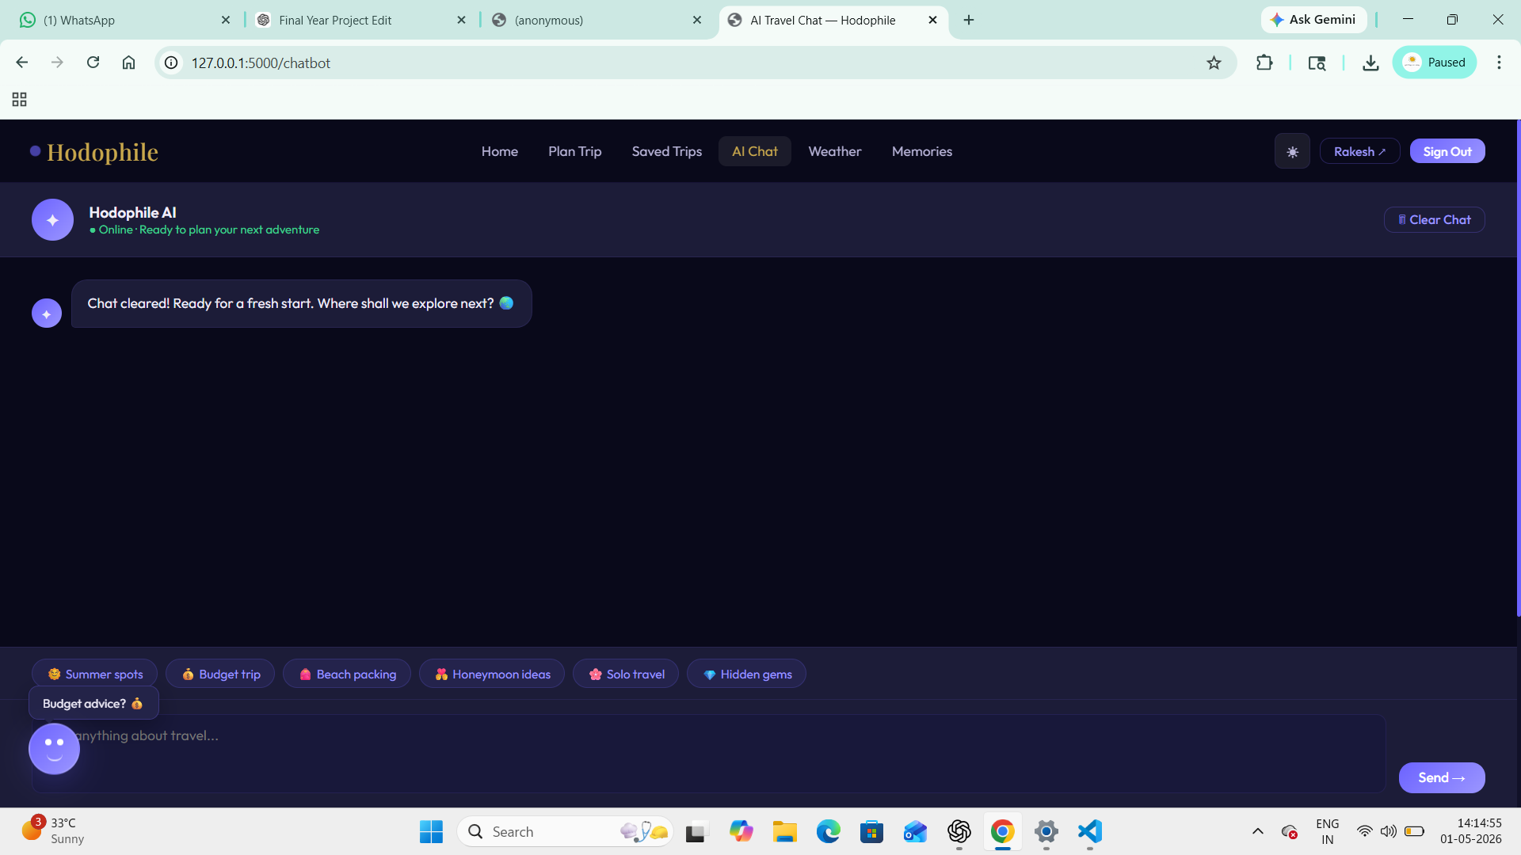
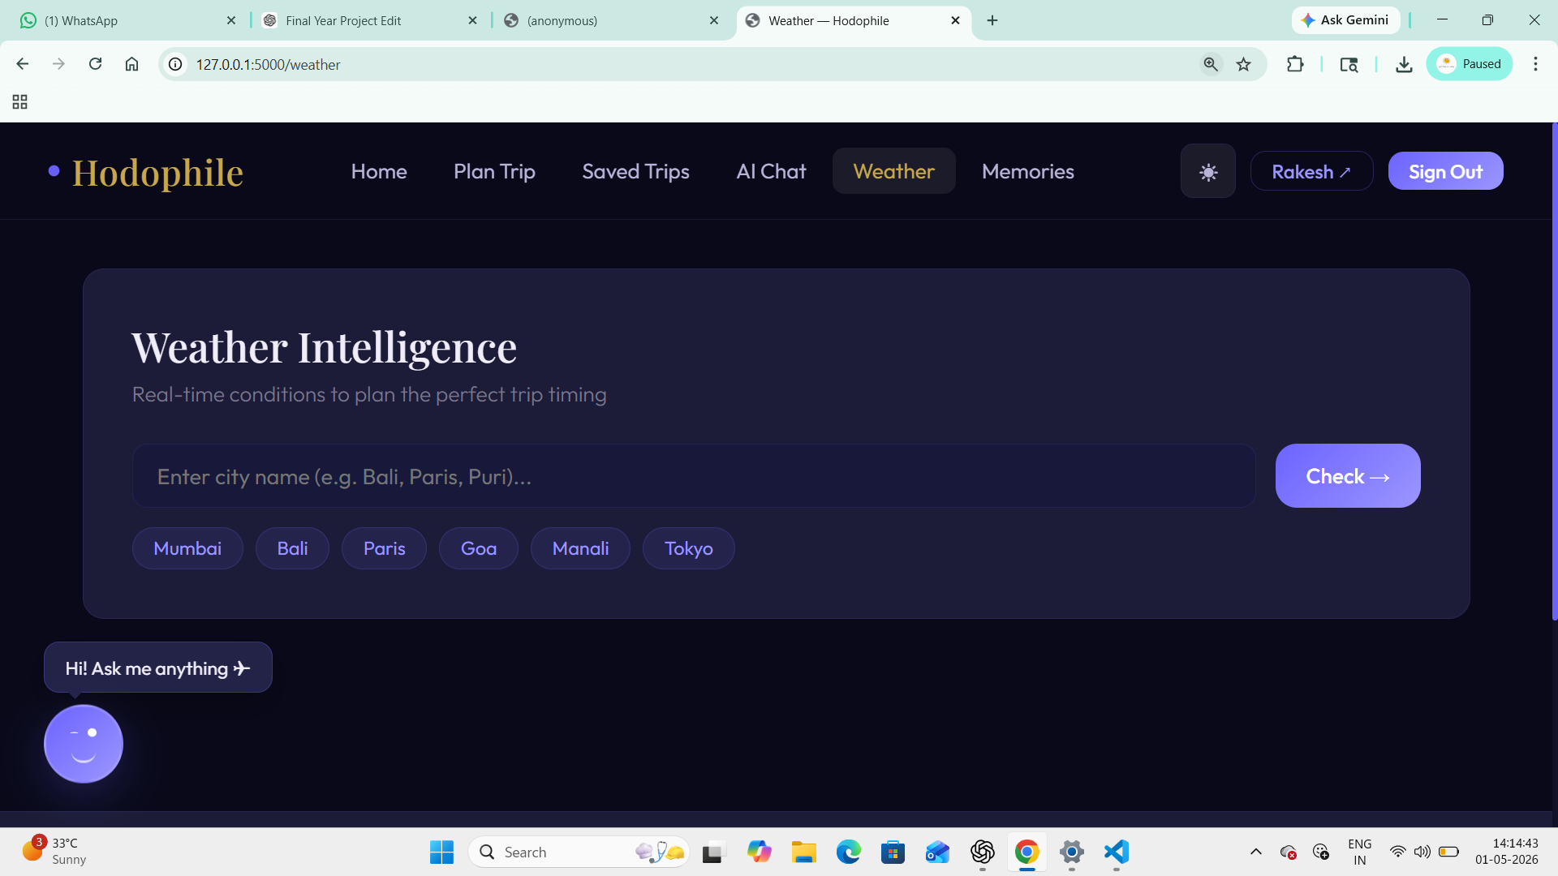
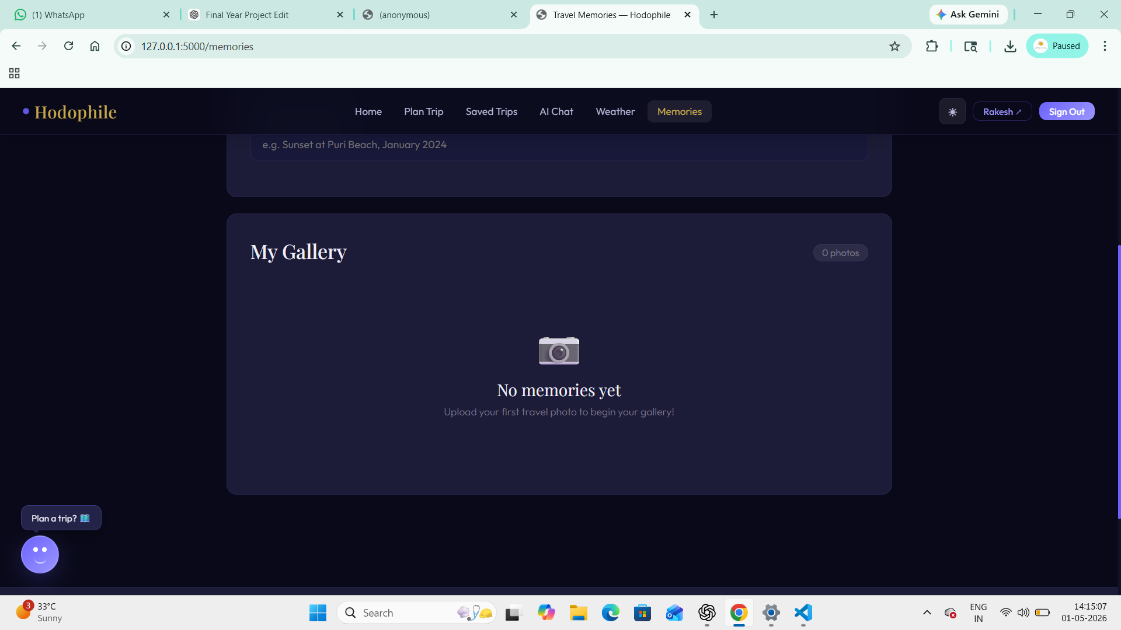
UI
UI Showcase — Page Screenshots
🏠
📝
📋
Home Page
Trip Planner
AI Result
Hero · Stats · Feature Cards
Destination · Budget · Group Form
Day-wise Itinerary · Budget Breakdown
Insert Screenshot
Insert Screenshot
Insert Screenshot
🤖
🌤
📸
AI Chatbot
Weather
Memories
Real-time Gemini-powered Q&A
Live API · Temp · Humidity · Wind
Upload Gallery · Photo Management
Insert Screenshot
Insert Screenshot
Insert Screenshot

Slide 12
EVALUATION
Advantages & Limitations
✅ Advantages
⚠ Limitations
All-in-one platform eliminating app-switching
AI-powered personalised itinerary generation
Real-time weather integrated into planning
Zero-cost open-source technology stack
Fully responsive — works on any device
Travel memories gallery for long-term value
Secure authentication with password hashing
Google Maps links for every destination
Requires active internet connection
No flight / hotel booking integration
API free-tier usage limits apply
SQLite not suited for large-scale production
No native mobile app (web only)
AI chat doesn't retain cross-session memory
File uploads stored locally (not cloud)

Slide 13
FUTURE
Future Enhancements
📱
Mobile App
✈
Booking API
Native Android & iOS app using Flutter with push notifications for weather & travel alerts
Direct flight & hotel booking via Amadeus or Skyscanner API integration
🧠
ML Personalisation
☁
Cloud Storage
Machine learning recommendations based on user travel history & behavioural patterns
Migrate memories to AWS S3 or Firebase for scalable & globally accessible media
💱
Currency Converter
📄
PDF Export
Real-time currency conversion for international trip budget management
Export AI-generated itineraries as downloadable, shareable PDF documents
🌐
Multi-language
👥
Community
i18n support for Hindi, Odia & other regional languages
Social travel network where users share reviews, photos & recommendations

Slide 14
CONCLUSION
✈
Conclusion
Hodophile successfully demonstrates that an AI-powered, integrated travel planning system can significantly improve the travel experience — from planning and preparation to memory preservation.
✦
All 25 test cases passed with 100% success rate
✦
7 modules fully implemented and integrated
✦
Real Gemini AI + Live Weather API working in production
✦
Responsive UI with Dark/Light mode — works on all devices
✦
Built entirely with free, open-source tools at zero cost
Hodophile — making every journey smarter, simpler, and more memorable.

Slide 15
Thank You
for your kind attention
Submitted by: Prangya Paramita Satpathy , Rakesh Kumar Chand , Swarupananda Rana , W.Lingaraj
Guide: Prof. Pravakar Mishra, HOD, Dept. of MCA
Q & A — We welcome your questions ✈

